Slide 1


Titolo presentazione sottotitolo
Non-traditional approaches to input corruption in Collaborative Denoising Autoencoders
Milano, XX mese 20XX
Student: Laura Cristina Schiatti Sisó
Supervisor: Paolo Cremonesi
MSc. in Computer Science and Engineering
Dipartamento de Elettronica, Informazione e Bioingegneria

Slide 2


Context: Recommender Systems
RECOMMENDATIONS ARE EVERYWHERE
Traditional approaches to recommenders still have challenges to face.
Use deep learning models for recommender systems.
Provide recommendations
to the users
<Collaborative filtering>

Slide 3
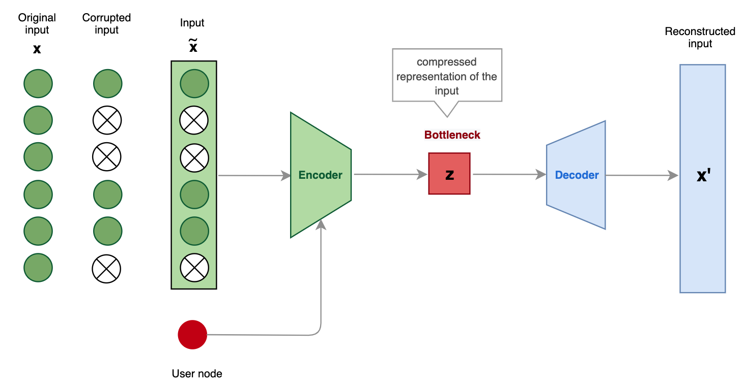

Problem and scope
Denoising trick
Collaborative Denoising Autoencoder (CDAE)
< for a generic user u>
User-specific
latent vector
The type of noise affects the representation learned.
Common choices are stochastic and difficult to control.

Slide 4


Proposed work
1
To replicate the experiments for the CDAE proposed by the authors to check whether the obtained results are similar, better or worse.
2
To propose two alternative approaches to input corruption in CDAE: with and without replacement.

Slide 5
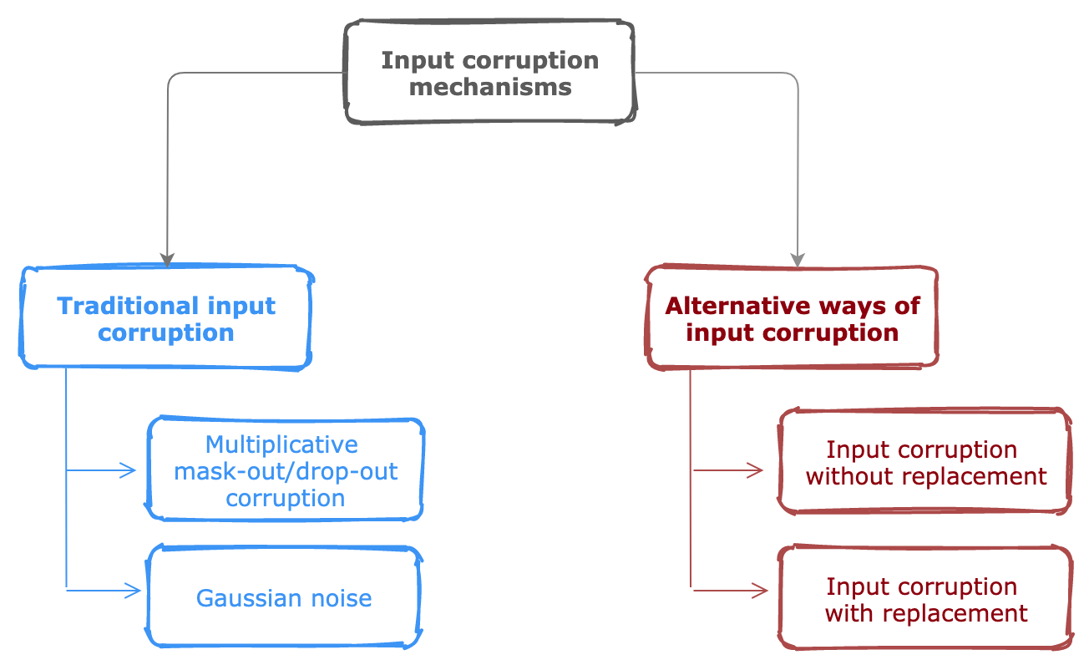
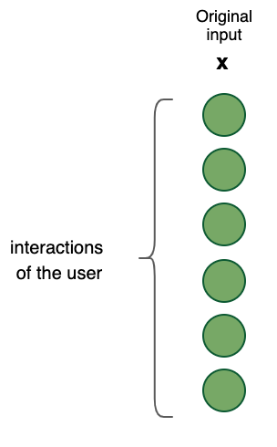


Input corruption formalization
Input: user profiles
Explicit
Implicit
Reviews
Behaviors
Corruption used in CDAE
Input used in CDAE

Slide 6
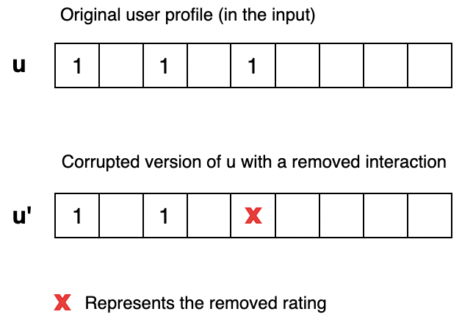
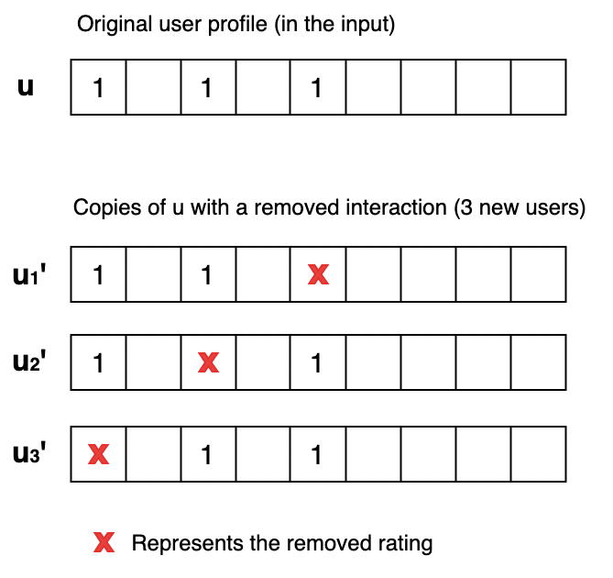


Input corruption formalization
Without replacement corruption
With replacement corruption
It can be extended so as to remove n interactions.
Data augmentation approach

Slide 7

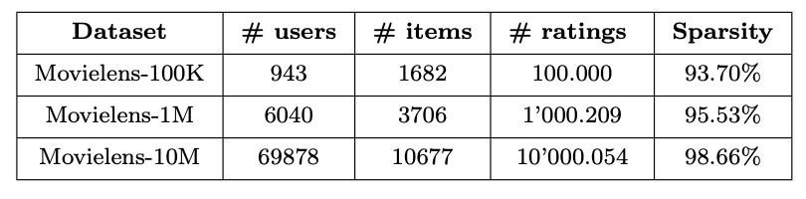


Results and Discussion: Setup
Benchmark datasets:
Used in the paper
interactions
Preprocessing:
Binarize the datasets.
Data splitting user-wise.
Evaluation: MAP@5 and MAP@10.
80%
20%
Training
Test

Slide 8
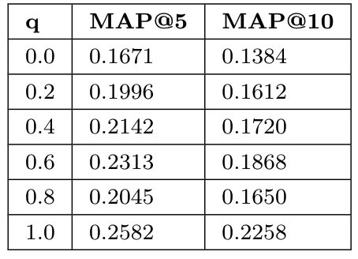
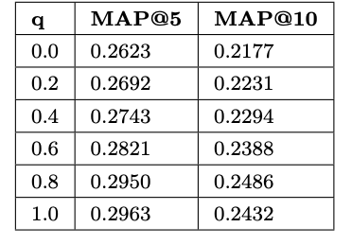
Results and Discussion: Comparison
CDAE using mask-out/drop-out corruption trained using different corruption levels (q)
These results correspond to MovieLens 10M
Level of noise
0.0
1.0
no corruption
complete corruption
Best performance
CDAE configuration 1
CDAE configuration 2
For maximum corruption, the results are better than any of the values in the original paper.

Slide 9
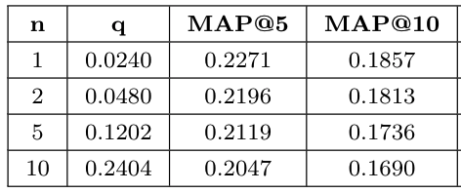
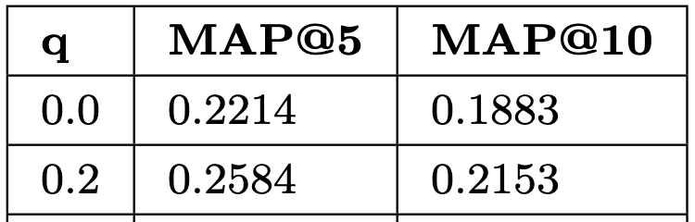
Results and Discussion: Input corruption
Compare different input corruption strategies using q.
These results correspond to MovieLens 100K .
Without replacement corruption
Mask-out/drop-out corruption
<baseline>
Similar results were obtained by removing a portion of the interactions, instead of a fixed number of interactions.
Removed interactions (n)
Performance

Slide 10
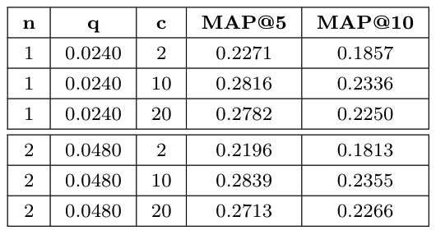
Results and Discussion: Input corruption
Compare different input corruption strategies using q.
These results correspond to MovieLens 100K.
With replacement corruption
Mask-out/drop-out corruption
<baseline>
Corrupted replicas by user (c)
<depending on
the problem at-hand>
n: number of removed interactions
Performance

Slide 11
Conclusions
Reproducibility of the code problem.
The experiments were reproduced without achieving the same results described in the paper.
There is no clear reason for the difference in the results.
Maybe due to assumptions on the code, bugs or even intrinsic randomness of the model.

Slide 12
Conclusions
The alternative ways to introduce corruption into the input did perform at least as well as the traditional approach used by the standard CDAE.
The with replacement corruption, consistently outperforms across datasets and metrics, the other corruption mechanisms. But there must be a trade-off.
The CDAE implementation was extended so as to be flexible in terms of the corruption mechanism and produced comparable results.

Slide 13
Thanks for your attention
Questions?

Slide 14

Firma convenzione Politecnico di Milano e Veneranda Fabbrica del Duomo di Milano
Backup slides
Aula Magna – Rettorato
Mercoledì 27 maggio 2015

Slide 15
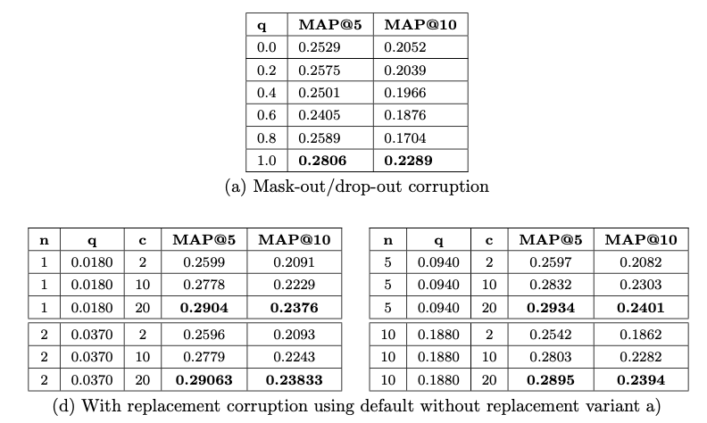
Input corruption using MovieLens 1M

Slide 16
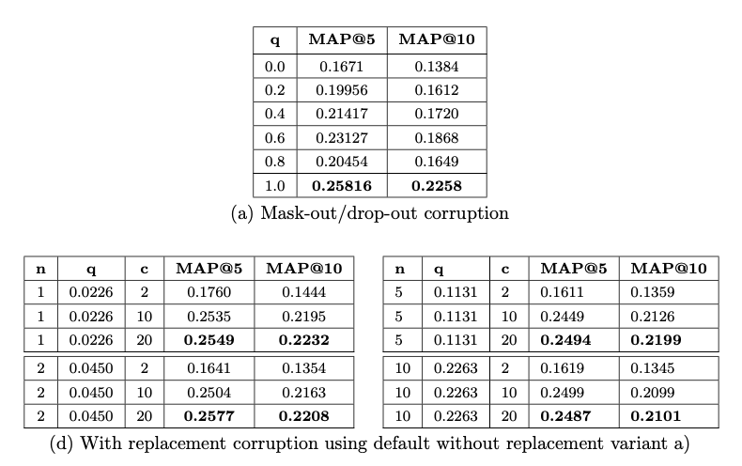
Input corruption using MovieLens 10M

Slide 17
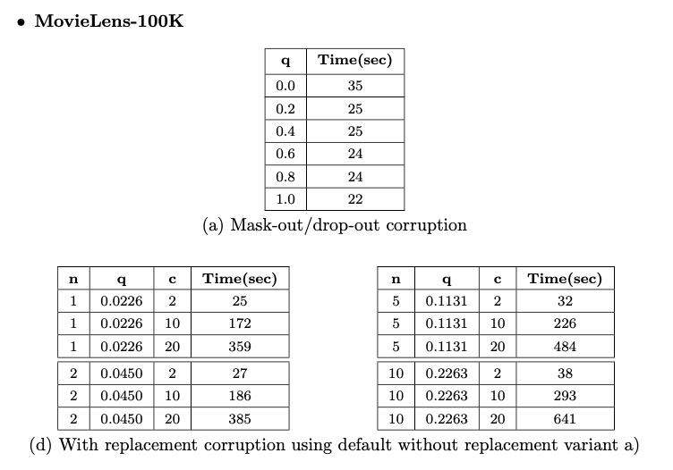
Execution time MovieLens 100K
<Mask-out/drop-out corruption>
<With replacement corruption>
Corruption level (q)
Corrupted replicas by user (c)
< and removed interactions (n)>
Execution time
Execution time

Slide 18
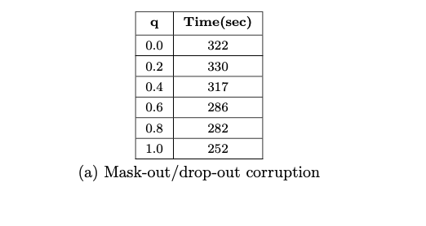
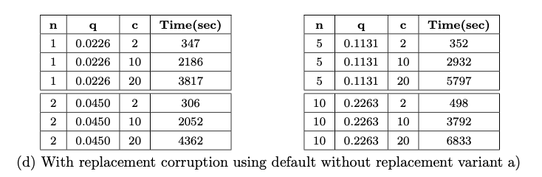
Execution time MovieLens 1M

